Slide 1
Telco Customer Churn Strategy
Predictive Retention and Value Prioritization
Leveraging Machine Learning to Optimize Budget and Reduce High-Value Attrition.

Slide 2
Executive Summary
Core Problem: High-risk customers are expensive to save, and budget is wasted on low-value customers.
Solution: An integrated ML pipeline was developed to predict risk and quantify customer value (CLTV).
Result: Identified 153 customers for urgent action (High Risk, High Value).
Primary Recommendation: Offer a significant discount on the Monthly Charge (to address their high cost/risk factor) in exchange for signing a Two-Year Contract (to capture the long-term value identified by the regressor).
Model Performance: Churn Classifier AUC of 0.87

Slide 3
Methodology Overview
Goal: Create a Prioritization Matrix by merging three ML insights.
Pipeline:
Unsupervised ML (Clustering): Defined 4 actionable segments (Urgent Churners, Phone Users).
Supervised ML (Classification): Predicted P(Churn) (who is leaving)
Regression Analysis: Predicted CLTV (who is worth saving).
Key Validation: The ClusterID was the single most important feature for churn prediction.

Slide 4
Customer Segmentation (K-Means Output)
Segment (Cluster ID) | Churn Rate | Tenure | Core Insight
High Value Loyalists | 9.9% | 58.5 months | High Value, High Commitment, Lowest Risk
Mid-Tier Customers | 19.5% | 25 months | Moderate Value, Moderate Commitment, Flexible
Phone Users | 7.9% | 29.6 months | Lowest Value, High Commitment, Stable
Urgent Churners | 61.4% | 15.9 months | High Cost, Low Commitment, Highest Risk
75% of our most critical customers belong to one group: Urgent Churners

Slide 5
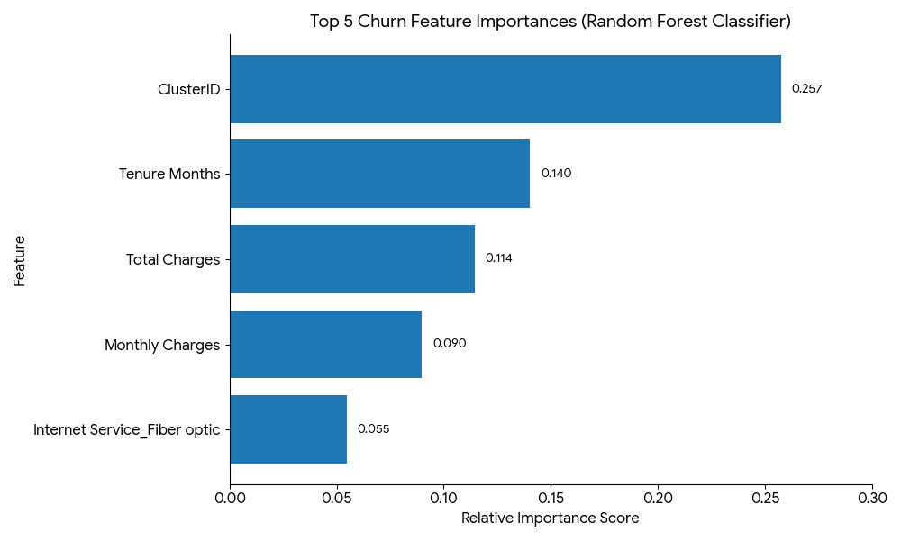
Churn Risk Drivers (Classification Model)
Top 3 Drivers of Churn Risk (P(Churn))
ClusterID (Behavioral Group)
Tenure Months (Low tenure = High risk)
Total Charges (High charges = Low risk)
Risk is driven by ClusterID and Time

Slide 6
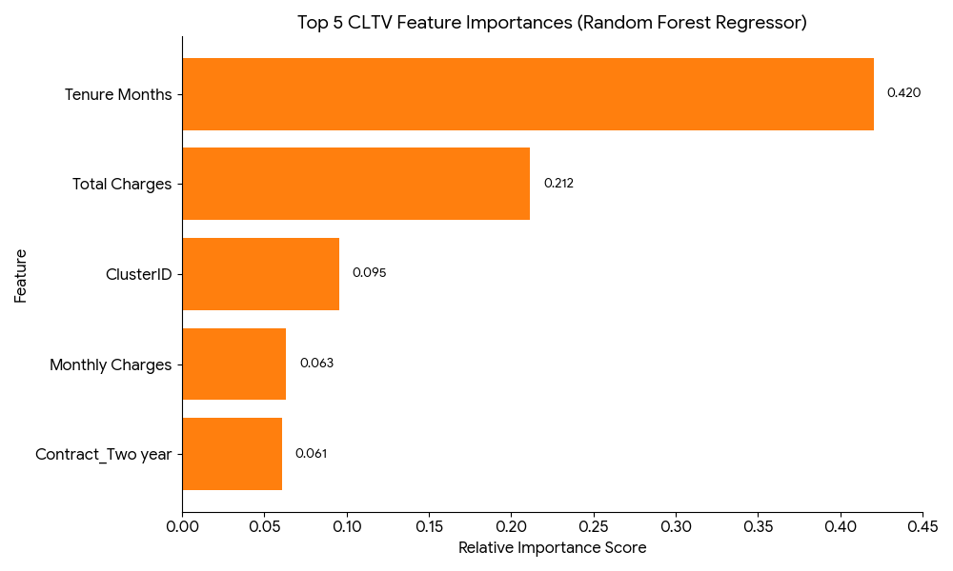
Customer Value Drivers (Regression Model)
Top 3 Drivers of Value (CLTV)
Tenure Months (Longer tenure = Higher value) Tenure Months (Low tenure = High risk)
Total Charges (High charges = High Value)
ClusterID (Behavioral Group)
Value is driven by Longevity and commitment

Slide 7
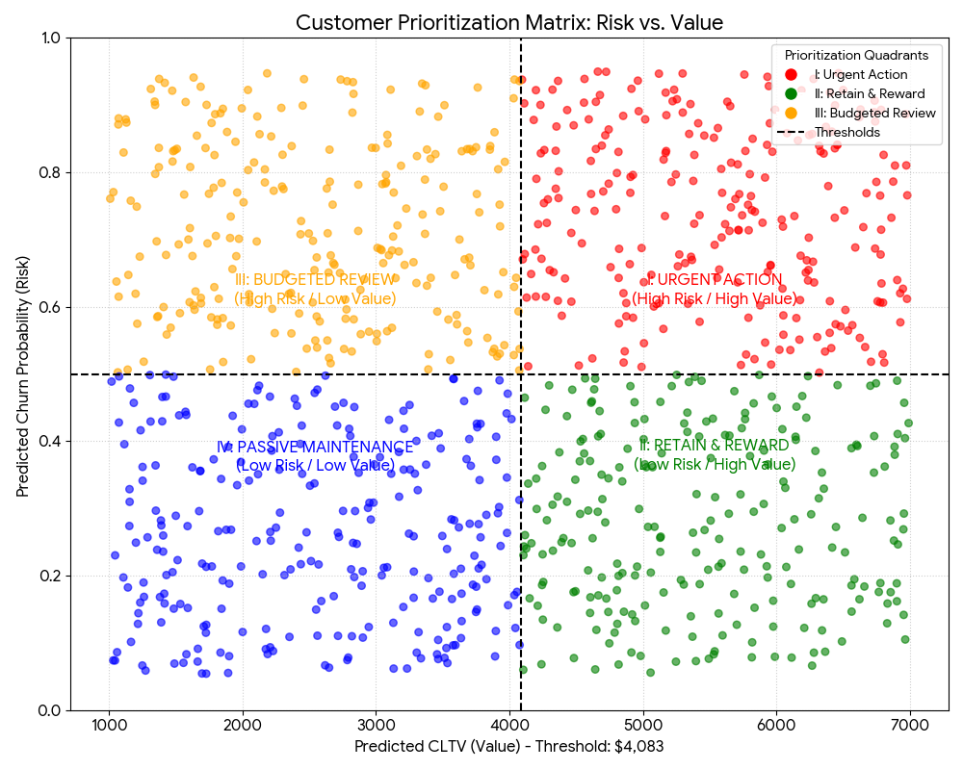
The Prioritization Matrix (The Action Plan)
Key Finding: 74.5% of customers in the Urgent Action quadrant belong to the high-risk Cluster 3 segment, confirming the target pool.
Focus Budget on 153 customers in Urgent Action quadrant for maximum ROI

Slide 8
The Specific Retention Offer
Target Group: Quadrant I (The 153 Urgent Action Customers).
Strategy Rationale: Address both the risk factor (cost) and the value factor (commitment).
The Offer: “Receive a 15% discount on your monthly bill for 12 months, contingent upon signing a Two-Year Contract.”
Justification: This addresses the high Monthly Charge risk factor while securing the high CLTV associated with the Two-Year Contract value driver.

Slide 9
Secondary Recommendations
Budget Management (QIII): Cease deploying high-cost retention offers to Low-Value/High-Risk customers. Use resources mostly on the 153 targets.
Proactive Rewards (QII): Maintain satisfaction in the Low-Risk/High-Value group (High Value Loyalists) with low-cost, high-goodwill offers (e.g., free feature upgrade) to prevent them from entering the high-risk zone.
Future Work: Use the CLTV model to evaluate the financial return of all new marketing campaigns

Slide 10
Conclusion
We have the model, the target, and the strategy.
The next step is the Integration of the P(Churn) score into the CRM system to track the 153 customers in real-time.

